Slide 1

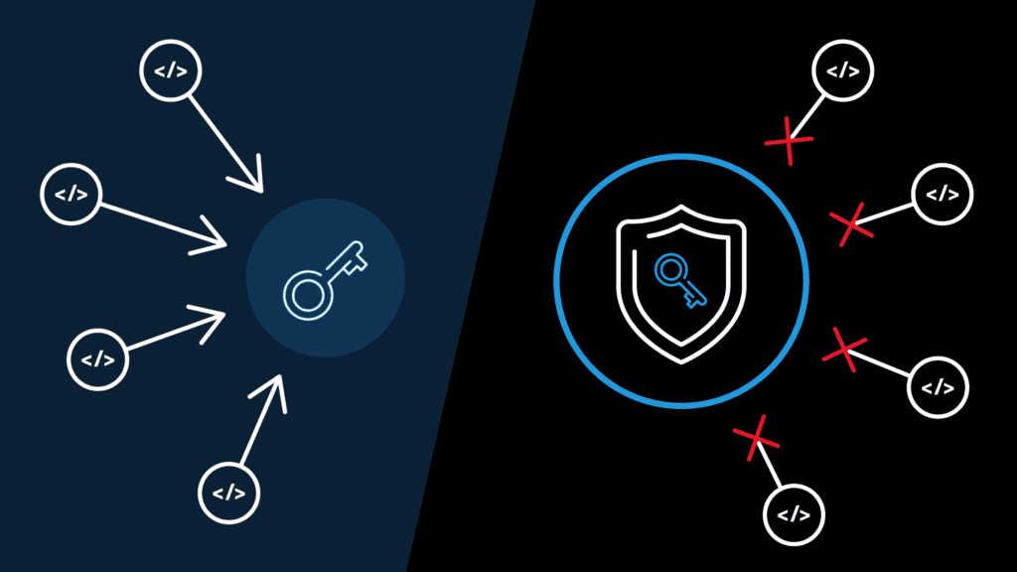
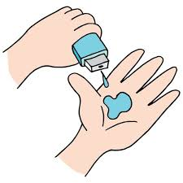
Cyber security in
Edunet
foundation
IBM SkillsBuild
H
Passwordless Authentication
Passwordless authentication is the next level security of method verifying by the users.

Slide 2
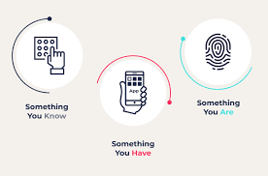
PASSWORDLESS AUTHENTICATION SYSTEM
Passwordless authentication is a means to verify a user’s identity, without using a password. Instead, passwordless uses more secure alternatives like possession factors (one-time passwords [OTP], registered smartphones), or biometrics (fingerprint, retina scans).
Passwords haven’t been safe for a long time. They are hard to remember, and easy to misplace. They are also the number one target of cybercriminals. So much so that 81 percent of breaches involve weak or stolen passwords.

Slide 3

AGENDA
Passwordless authentication systems are being developed to address by using the current concerns of the security.
It can increases security by using two-factor authentication (you know something and something you have).
It can eliminates the changing of the password.
It can eliminates the need for using the long passwords.
There are more other secure passwords based on the authentication. Passwordless authentication is the more secure based on the other system, it can helps us to easily longin to the system.

Slide 4

PROBLEM STATEMENT
In passwordless authentication, we don’t need the password for login the website .
There are so many ways to login a website,like one time passwords(OTP),authentication using the artificial intelligence based.
We don’t need password for login an application in this authentication.
Some of the people cant remember the passwords ,so that this authentication is useful and secure.

Slide 5

PROJECT OVERVIEW
Passwordless authentication works by replacing passwords with other authentication factors that are intrinsically safer.
In password-based authentication, a user-provided password is matched against what is stored in the database.
In some passwordless systems, like biometrics, the comparison happens in a similar manner, but instead of passwords, a user’s distinctive characteristics are compared.
E.g., a system captures a user’s face, extracts numerical data from it, and then compares it with verified data present in the database.
In other passwordless implementations, comparisons may happen differently. Eg. a system sends a one-time passcode to a user’s mobile, via an SMS.
The user receives it and enters it into the login box. The system then compares the user-entered passcode to the one it had sent.

Slide 6
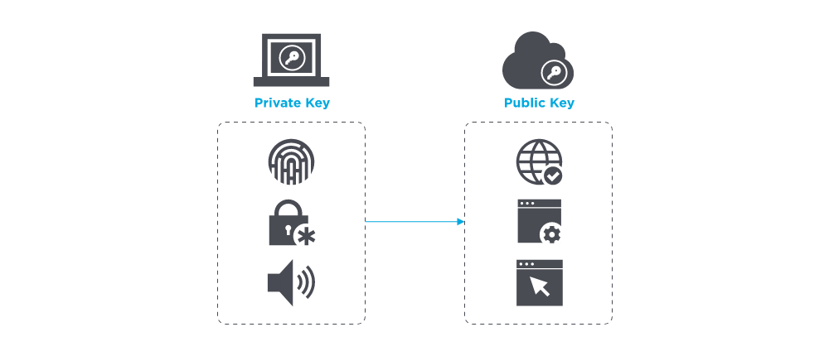
Passwordless authentication relies on the same principles as digital certificates: a cryptographic key pair with a private and a public key.
Although they are both called keys, think of the public key as the padlock and the private key as the actual key that unlocks it.
Digital certificates work in a way in which there is only one key for the padlock and only one padlock for the key.
A user wishing to create a secure account uses a tool (a mobile app, a browser extension, etc.) to generate a public-private key pair.
The private key is stored on the user’s local device and can only be accessed using an authentication factor, e.g., a fingerprint, PIN, or OTP. The public key is provided to the system on which the user wishes to have a secure account.

Slide 7

WHO ARE THE END USERS?
Online shopping users can use the application and order anything in the online.
In this only our country are selling anything in the online and these are also we can make them business.
In this consumers are buy products in the online and the business people who sell their products into the online.
I think people are the end users ,because 90 percent of the people can make the products in the online.
And some of the users can make it as online business.
Not only in india,other countries like united states, China etc are doing the same .

Slide 8

YOUR SOLUTION AND ITS VALUE PROPOSITION
There are many ways to authenticate a user besides the traditional password.
There is clear and apparent reason why 92% of business believe going passwordless in the future of system-access security- the benefits outweigh the costs.
One of the newest password is one time passwords passwordless authentication.
One time password is an easy way to avoid using the password altogether.
The most common use case of one time password is when you want to login from a new device (like laptop).

Slide 9

THE WOW IN YOUR SOLUTION
Authentication is the process of verifying a user's identity. The term comes from the Latin word for "prove". Authentication is usually performed by comparing the user's identifying information to a database of users (a list of people with access to that system). If the person can be identified as one of those listed, then they are authenticated.
The benefits are:
1) It reduces fraud, as it is harder for someone to create a fake account or steal someone else’s credentials.
2) It reduces password fatigue, which occurs when users have to remember too many passwords and cannot easily keep track of them all.
3) In the past, companies had to invest in expensive and time-consuming security systems. With OTPS, they can cut down on their costs and also save time.
4) OTP authentication system is a software that generates a one-time password based on a secret key shared between the two devices. It is widely used in banking transactions and other online transactions.

Slide 10
MODELLING
Login Screen User Flow
Login Screen
Website
Existing User
Login
Yes
NO
Login
New user
Registration form

Slide 11
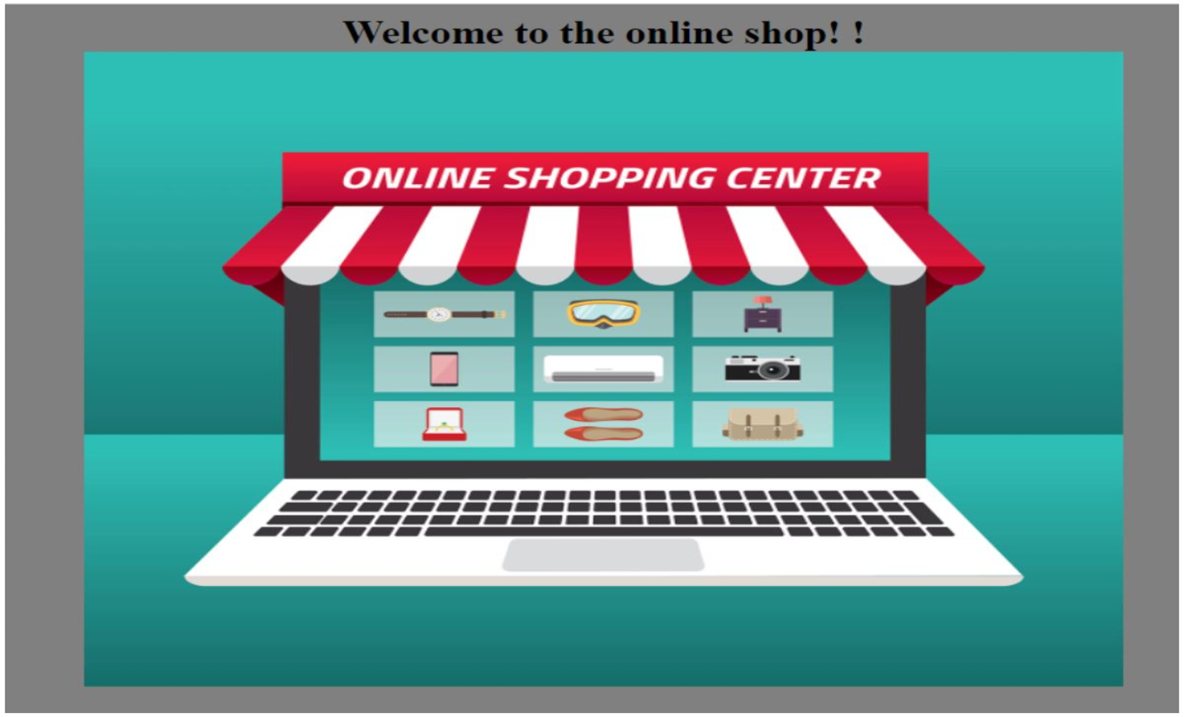
RESULTS
Demo Link

Slide 12

MEET OUR TEAM
RADHE SYAM MANDUVA
AICTE Email :radhesyamchowdary@gmail.com
AICTE Student ID :STU625127c2f24c81649485762
BRANCH :CSE 3rd year
COLLEGE :NRI INSTITUTE OF TECHNOLOGY,VISADALA,GUNTUR.
BATCH CODE :AICB2-0882
Internship ID :INTERNSHIP_166004054262f2355ecd0f9
Internship type :Cyber Security
.
.

